Slide 1

Inceptionism without DeepDream
Chetankumar Mistry

Slide 2
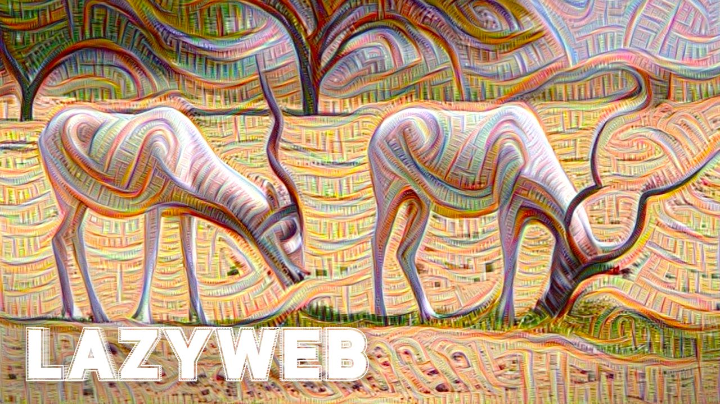
Background
DeepDream: Released in July 2015
Uses a convolutional neural-network
Creates hallucinogenic/dream-like images

Slide 3
Problem
Convolutional neural network isn’t transparent
Large number of processing rounds is costly (time and resources)
Just see if a similar output can be done without using a CNN
IE. Through basic image transformation techniques

Slide 4

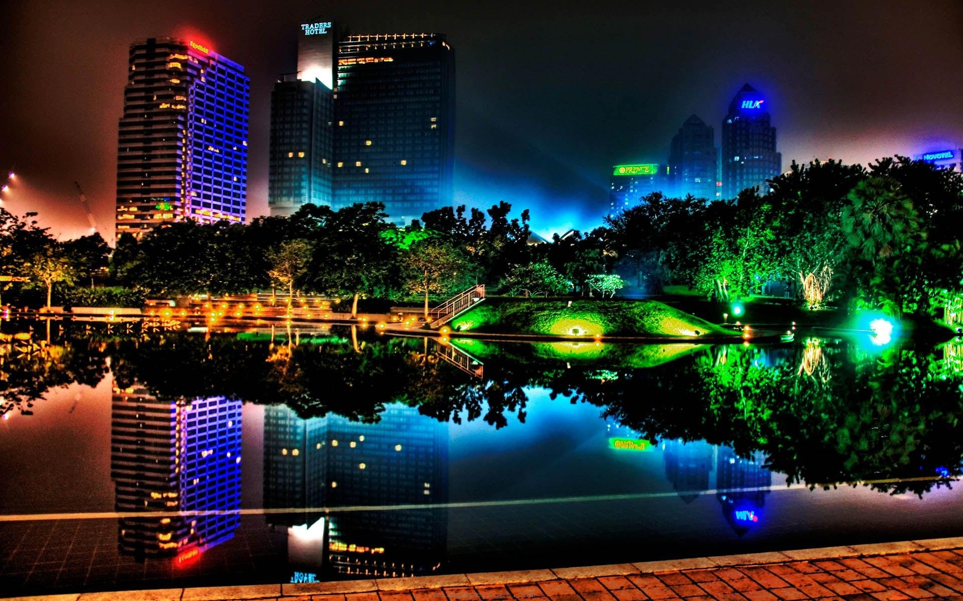
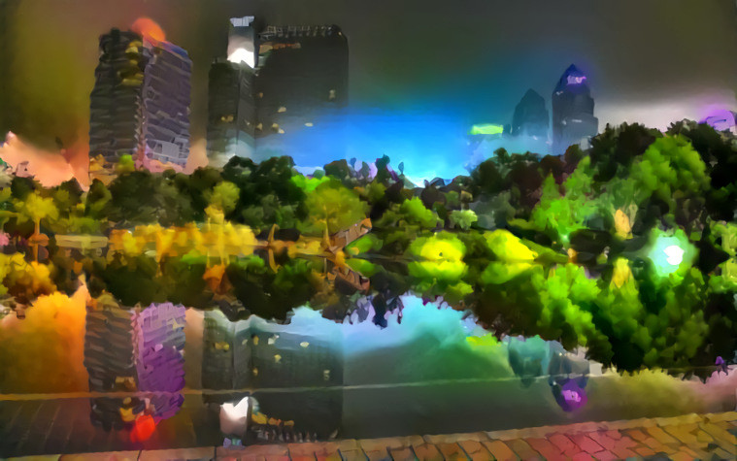
Solution Approach
Understand how DeepDream works
Tweak neurons and see how output varies
Lower-level neurons enhance more physical features (corners/edges)
Higher-level neurons much more abstract
Use the system available at https://deepdreamgenerator.com/
Takes 2 images, one as a style, and one as the body.

Slide 5
Solution
Started by creating programs which perform individual image transformations
Edge Detection
Line Enhancement
Burring and Smoothing
Erosion and Dilation
Then use individual programs together linking the output of one as the input of another

Slide 6
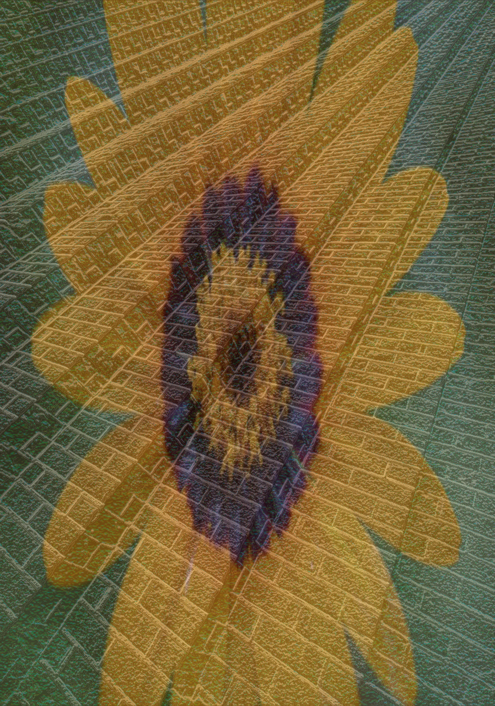


Results
Final program is a pipeline of transformation stages which takes in 2 images and continually processes and transforms them until a final output is produced.

Slide 7
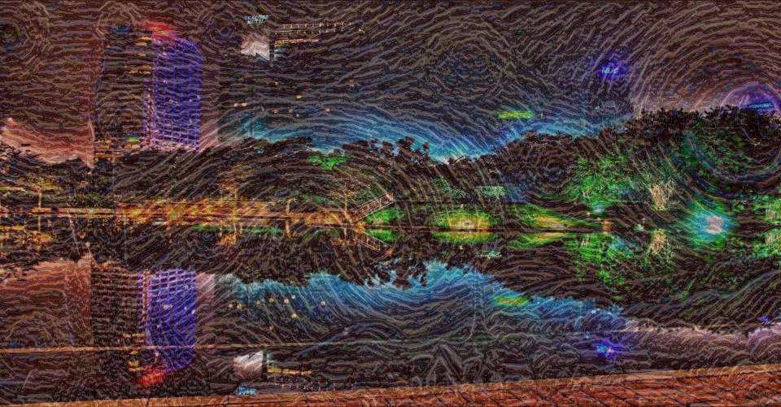
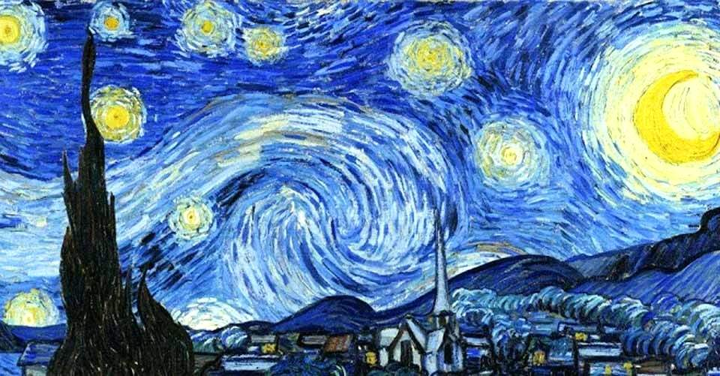
More Results

Slide 8
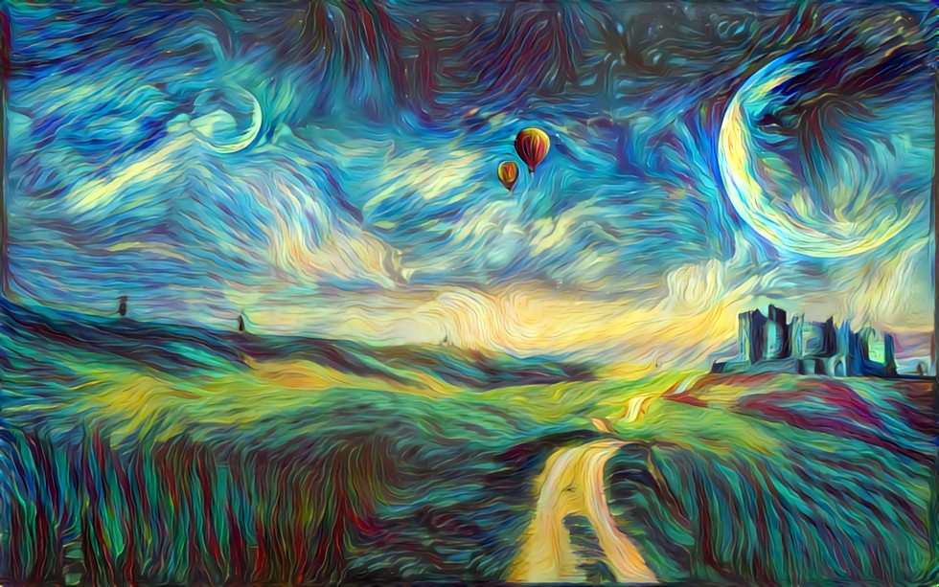
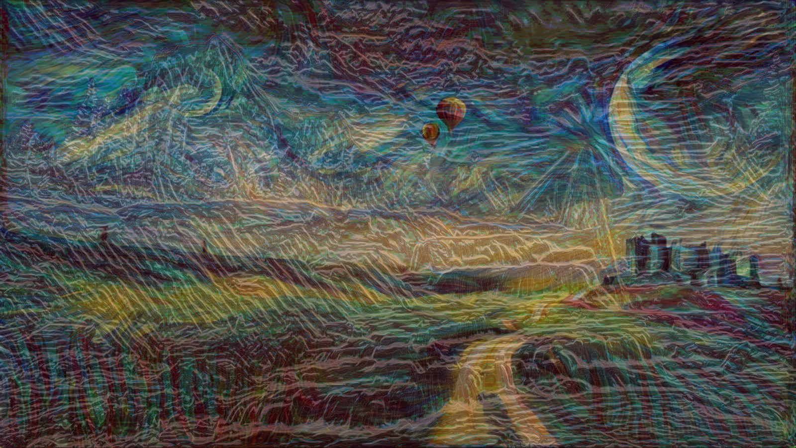
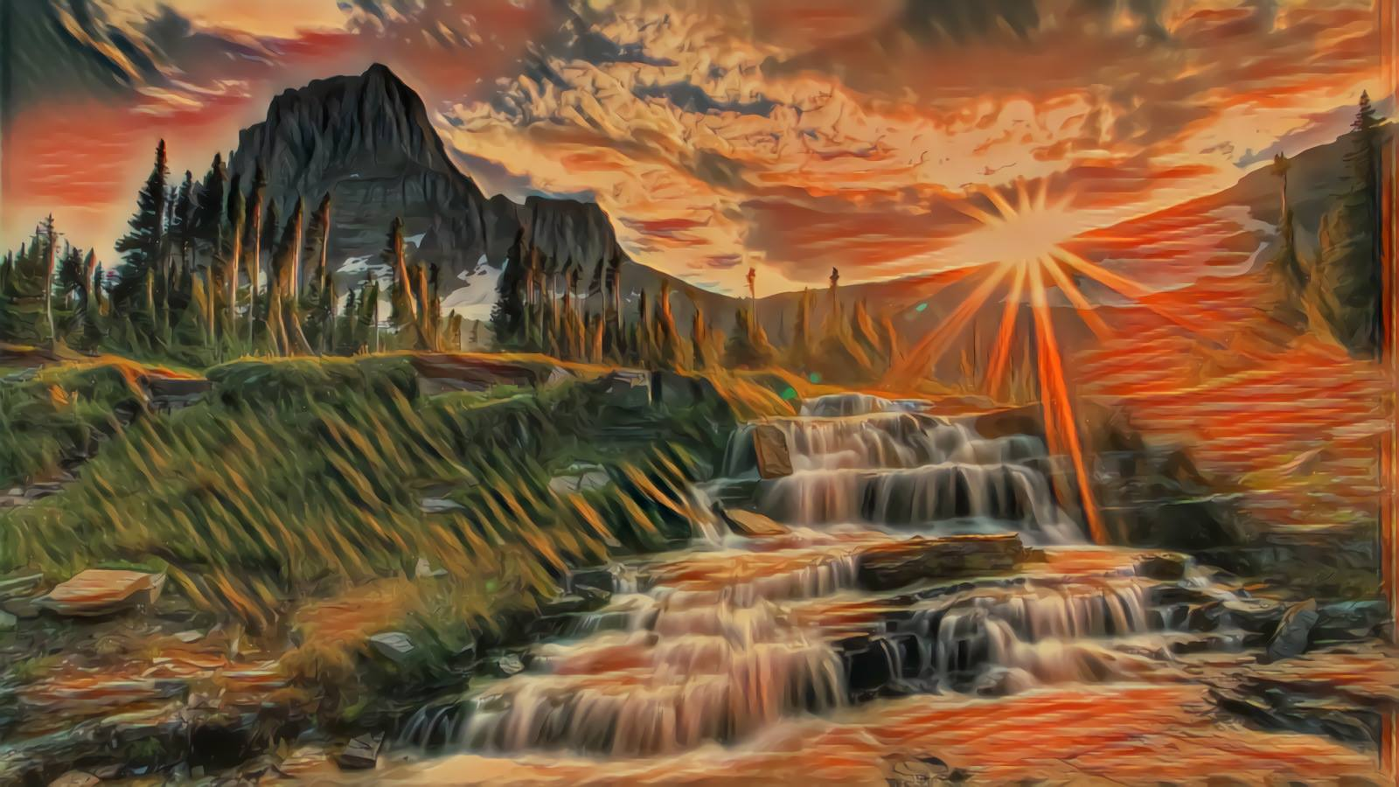

Slide 9
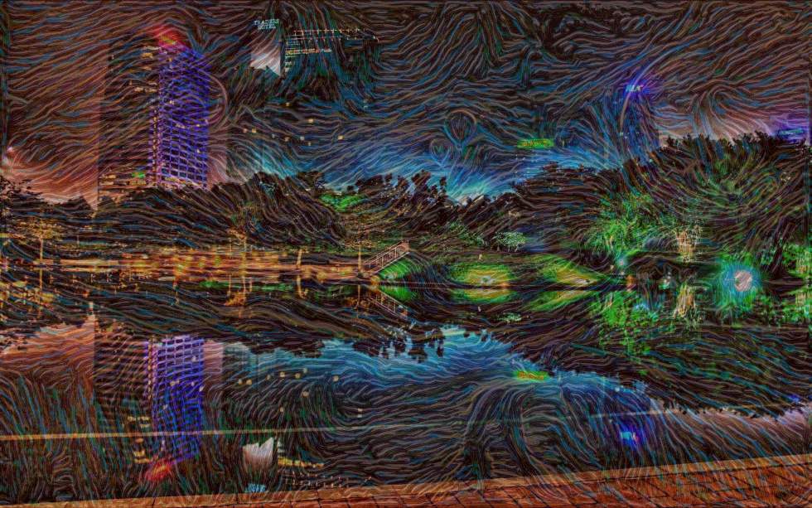

Slide 10
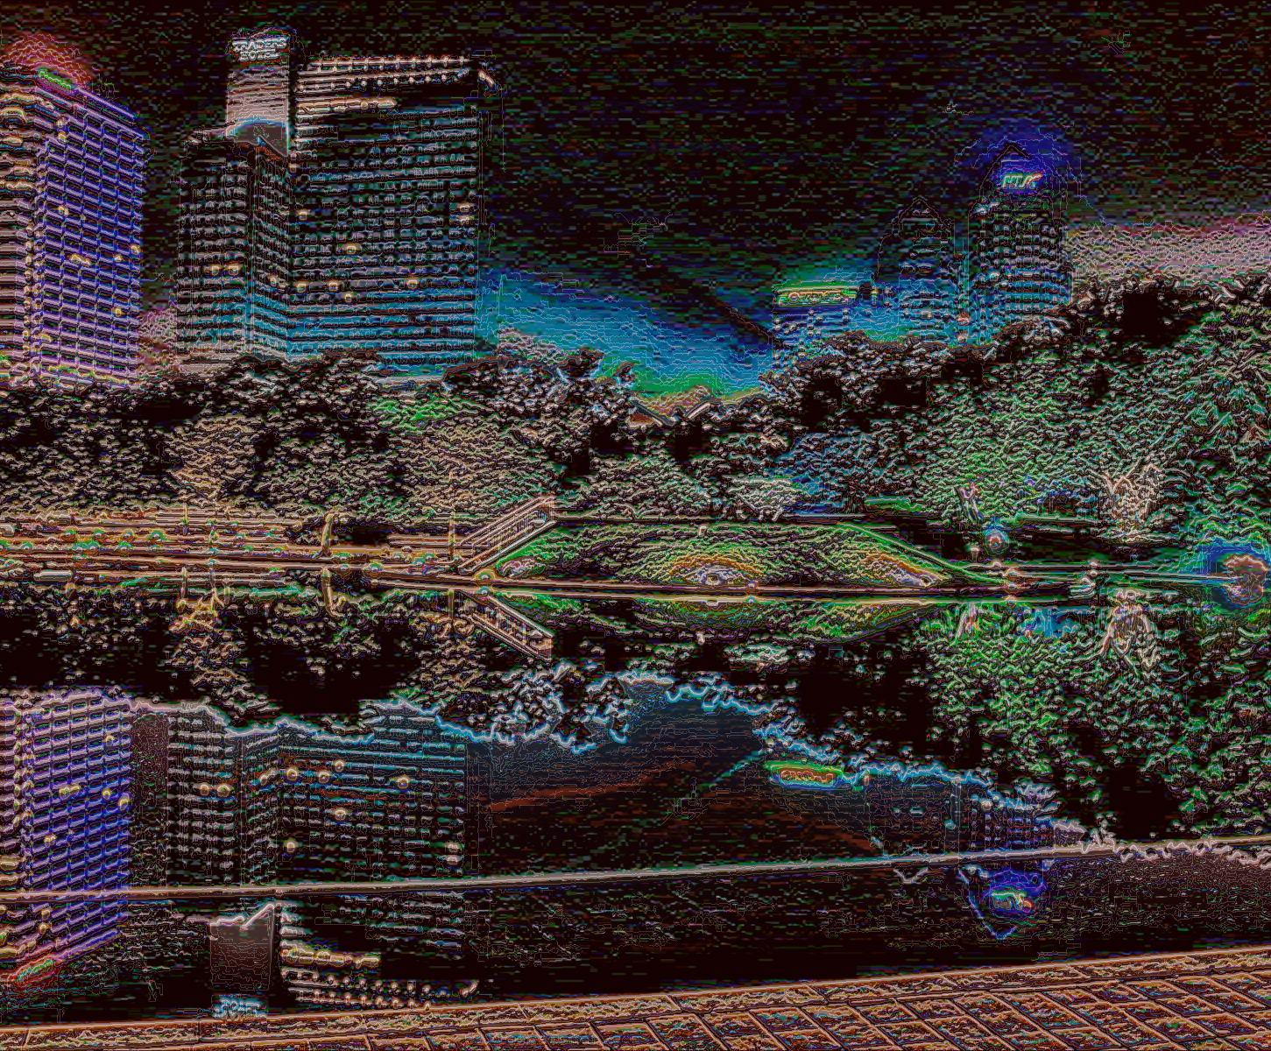

Slide 11
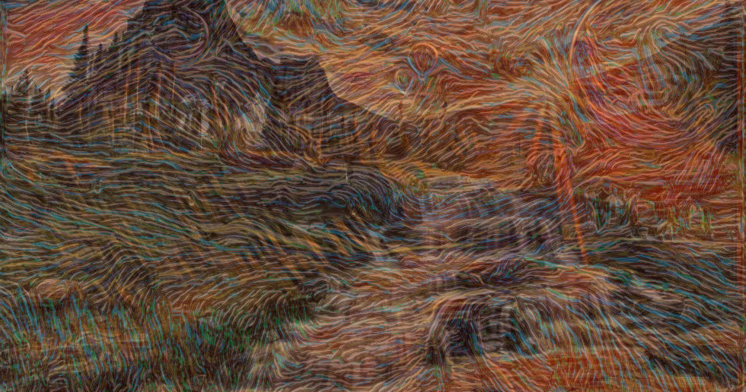
Thanks for Watching!

